Slide 1

US Inflation
Bonyshree Bose

Slide 2
What is inflation?
Inflation is an overall increase in the prices of goods or services in an economy. Over time, currency loses value and it doesn’t have as much purchasing power as it once did.
Reasons for Inflation?
Inflation can occur for a variety of reasons, like higher wages, lower interest rates, supply chain issues, or broader issues in the global economy.

Slide 3
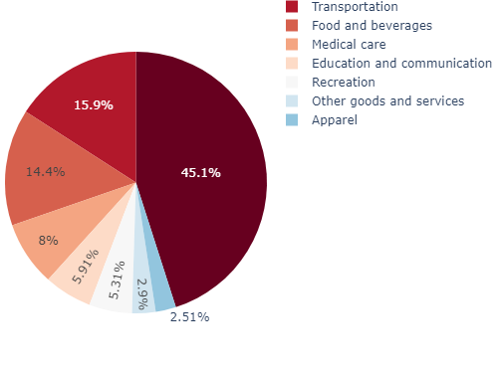
How is inflation measured?
Consumer Price Index for Urban Consumers (CPI-U) (Published by Bureau of Labor Statistics)
Average change in the prices of consumer goods and services
Prices in the CPI-U are given a weight based on their relative importance
Census regions: Northeast, South, Midwest, West
Notes:
The CPI-U shows changes in the prices paid by urban consumers for a “representative basket of goods and services.” or the most common goods and services purchased on an average month based on detailed surveys of what Americans spend their money on. The urban consumer group represents about 93% of the total US population.

Slide 4
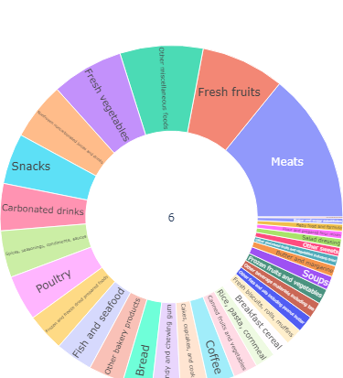
Food component sub-categories

Slide 5
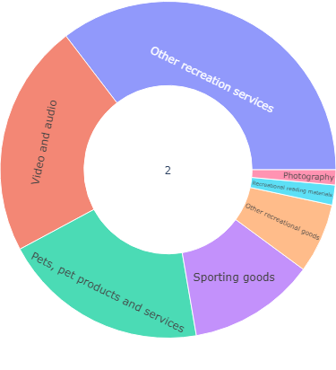
Recreation component sub-categories

Slide 6
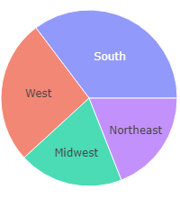
4 Census regions: Northeast, South, Midwest, West
9 Census divisions: New England, Mid Atlantic, East North Central, West North Central, South Atlantic, East South Central, West South Central, Mountain, Pacific
2 population-size classes: A (greater than 2,500,000) and B/C (2,500,000 or less), for the U.S. and the 4 Census regions
23 selected metropolitan areas: Chicago, Los Angeles, and New York are published monthly; the remaining areas are published bi-monthly

Slide 7
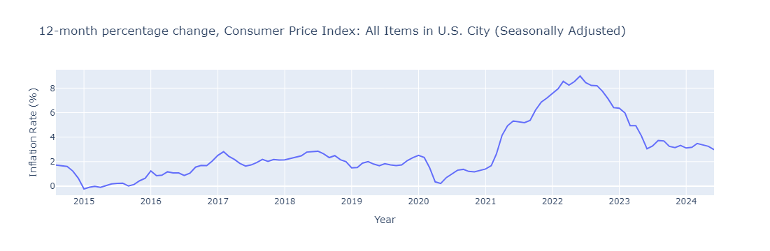

Slide 8
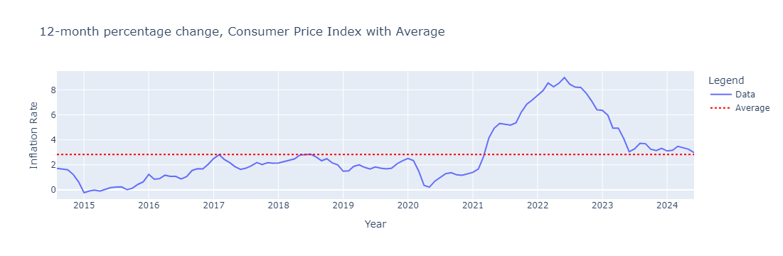

Slide 9
